Slide 1

Perl Training - Session 5
Dr. Prabhakar PhD
Senior Integration Engineer
Decision Minds, Bengaluru.

Slide 2
Contents
Object Oriented Perl – Part 2
Database Integration DBI
Web Hosting CGI
Perl Best Practices and Learning Resources
https://github.com/prabhakarg-dm/Perl-Training-Session1
https://github.com/prabhakarg-dm/Perl-Training-Session2
https://github.com/prabhakarg-dm/Perl-Training-Session3
https://github.com/prabhakarg-dm/Perl-Training-Session4
https://github.com/prabhakarg-dm/Perl-Training-Session5

Slide 3
Polymorphism: Method Overriding
Method overriding means having two methods with the same name but doing different tasks.
use strict;
use warnings;
use lib 'C:/Users...Session5-scripts/';
use Square;
my $a = Rectangle->new(5,10);
my $b = Square->new(4,4);
$a->getPerimeter();
$b->getPerimeter();
If there is any method in a superclass and a method with the same name in subclass, then by executing a method, the method from the corresponding class will be executed.

Slide 4
Polymorphism: Method Overriding
package Rectangle;
sub new{
my $class = shift;
my $self = {
'length' =>shift,
'breadth' =>shift
};
bless $self, $class;
return $self;
}
sub getPerimeter{
my $self = shift;
print "Perimeter of rectangle is ",2*($self->{'length'}+$self->{'breadth'}),"\n";
}
sub getArea{
my $self = shift;
return $self->{'length'}*$self->{'breadth'};
}
1;
package Square;
use strict;
use warnings;
use parent 'Rectangle';
sub getPerimeter{
my $self = shift;
print "Perimeter of square is ",4*($self->{'length'}),"\n";
}
1;

Slide 5
DBI Module
DBI::mysql
MySQL
Perl Script
DBI
DBI::Pg
PgSQL
DBI::SQLite
SQLite

Slide 6
MySQL DB Integration
Insert Data to MySQL Table
use DBI;
use strict;
my $driver = "mysql";
my $database = "perlbase";
my $dsn = "DBI:$driver:database=$database";
my $userid = "root";
my $password = "dm2019";
my $dbh = DBI->connect($dsn, $userid, $password ) or die $DBI::errstr;
my $name = "steve";
my $location = "pune";
my $sth = $dbh->prepare("INSERT INTO info
(NAME, LOCATION )
values
(?,?)");
$sth->execute($name,$location)
or die $DBI::errstr;
$sth->finish();
Notes:
Most of the time it is not even required to download all the data from the internet, instead just scrap and extract the required data and remove the unnecessary data.

Slide 7
MySQL DB Integration
Read Data to MySQL Table
use DBI;
use strict;
my $driver = "mysql";
my $database = "perlbase";
my $dsn = "DBI:$driver:database=$database";
my $userid = "root";
my $password = "dm2019";
my $dbh = DBI->connect($dsn, $userid, $password ) or die $DBI::errstr;
my $sth = $dbh->prepare("SELECT * from info");
$sth->execute() or die $DBI::errstr;
while (my @row = $sth->fetchrow_array()) {
my ($first_name, $last_name ) = @row;
print "Name = $first_name, Location = $last_name\n";
}
$sth->finish();
Notes:
Most of the time it is not even required to download all the data from the internet, instead just scrap and extract the required data and remove the unnecessary data.

Slide 8
MySQL DB Integration
Delete Data to MySQL Table
use DBI;
use strict;
my $driver = "mysql";
my $database = "perlbase";
my $dsn = "DBI:$driver:database=$database";
my $userid = "root";
my $password = "dm2019";
my $dbh = DBI->connect($dsn, $userid, $password ) or die $DBI::errstr;
my $sth = $dbh->prepare("DELETE FROM info WHERE NAME = 'john';");
$sth->execute() or die $DBI::errstr;
$sth->finish();
Notes:
Most of the time it is not even required to download all the data from the internet, instead just scrap and extract the required data and remove the unnecessary data.

Slide 9
Executing System commands from Perl
Script for running Dos commands on windows
use strict;
use warnings;
system “dir .txt";
system “md directory";
system “rd directory";
system "ren file1.txt file2.txt";
system “del file2.txt";
Script for terminal commands on Linux
use strict;
use warnings;
system "touch file1.txt file2.txt";
system "chmod 755 file1.txt";
system "mv file2.txt file3.txt";
system "rm -rf file3.txt";
system "date";
Notes:
Most of the time it is not even required to download all the data from the internet, instead just scrap and extract the required data and remove the unnecessary data.

Slide 10
Automating Downloads
Script for download a URL and storing it in a file
use strict;
use warnings;
use LWP::Simple;
my $url = 'https://files.rcsb.org/view/6LYZ.pdb';
my $file = '6LYZ.pdb';
getstore($url, $file);
Notes:
Once learnt a programmer can use Perl for his day today operations
And built a custom library of scripts that can be reused any number of times
This section will provide common example Perl scripts that could be used by the anyone depending upon his necessity.
Perl script can be written to automatically download pages from the internet, especially useful when the large parts of the urls are redundant.

Slide 11
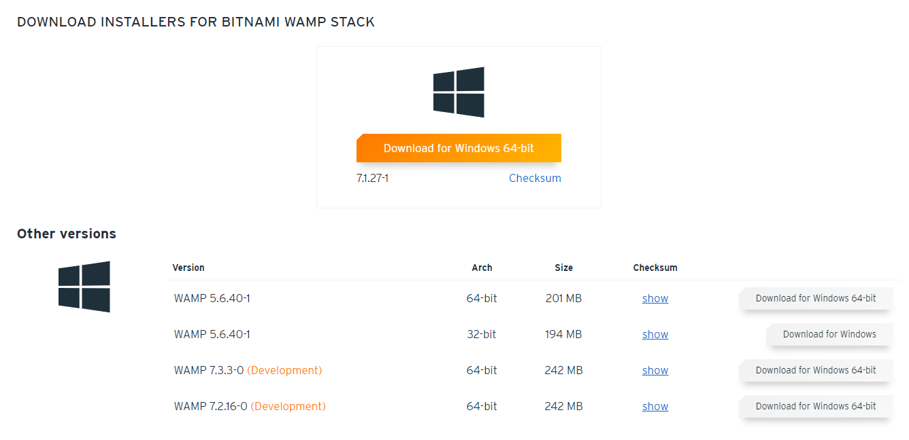
Installing Bitnami

Slide 12
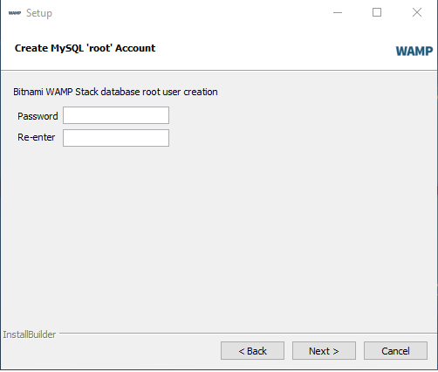
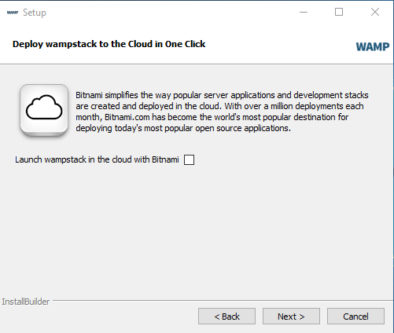
Installing Bitnami

Slide 13
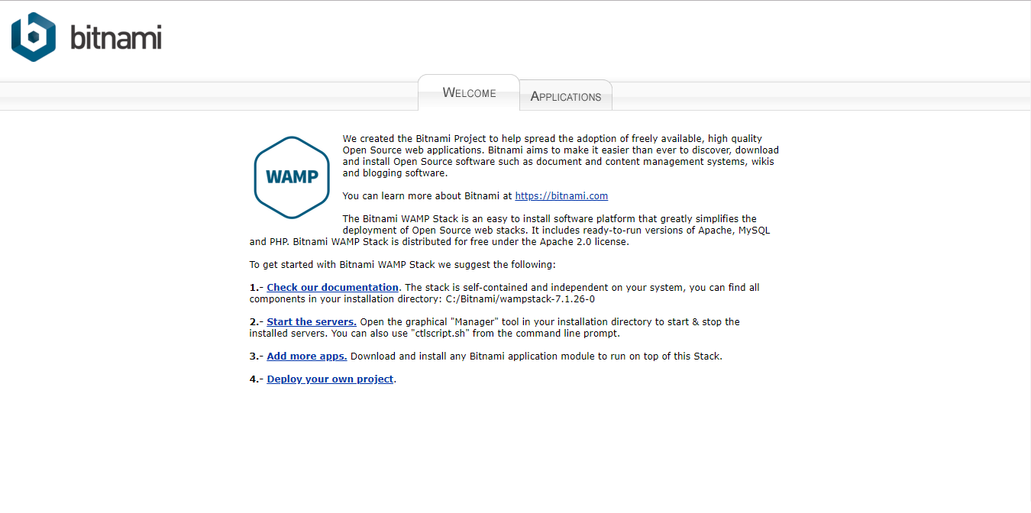

Slide 14
Perl-CGI
Install the CGI module using cpan> prompt.
Copy and paste the below script and save it in C:\Apache24\cgi-bin\ with the name cgitest.pl.
#!C:/Perl64/bin/perl.exe
print "Content-Type: text/html\n\n";
# Note there is a newline between
# this header and Data
# Simple HTML code follows
print "<html> <head>\n";
print "<title>Hello, world!</title>";
print "</head>\n";
print "<body>\n";
print "<h1>Hello, world!</h1>\n";
print "</body> </html>\n";
Testing Perl-CGI on Windows
Open your web browser and type http://localhost/cgi-bin/cgitest.pl.
If the “Hello World” is displayed on the browser, then you have successfully configured the Perl-CGI and your system is ready to host Perl backed websites.

Slide 15
Perl Project
HTML
Login Form
Perl
CGI Program
name
password
HTML
ERROR Page
HTML
Welcome Page

Slide 16

Perl Project

Slide 17
Perl Best Practices and Learning Resources
Advanced Perl Programming
Beginning_Perl
Damian Conway - Perl Best Practices
Learning Perl Objects References And Modules
Learning Perl
O'Reilly - Learning Perl 5th Edition
Perl Best Practices - Reference Guide
https://github.com/prabhakarg-dm/Perl-Books

Slide 18
Thank you

